Slide 1

FTK & Steganography
Team Pi

Slide 2
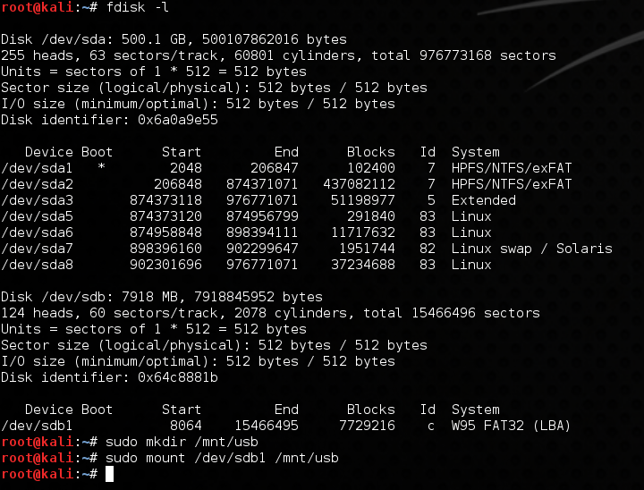
Find and Mount the drive in Linux
Make a folder for the drive
Use the command sudo mount /dev/sbd1 /mnt/usb to mount the logical drive

Slide 3
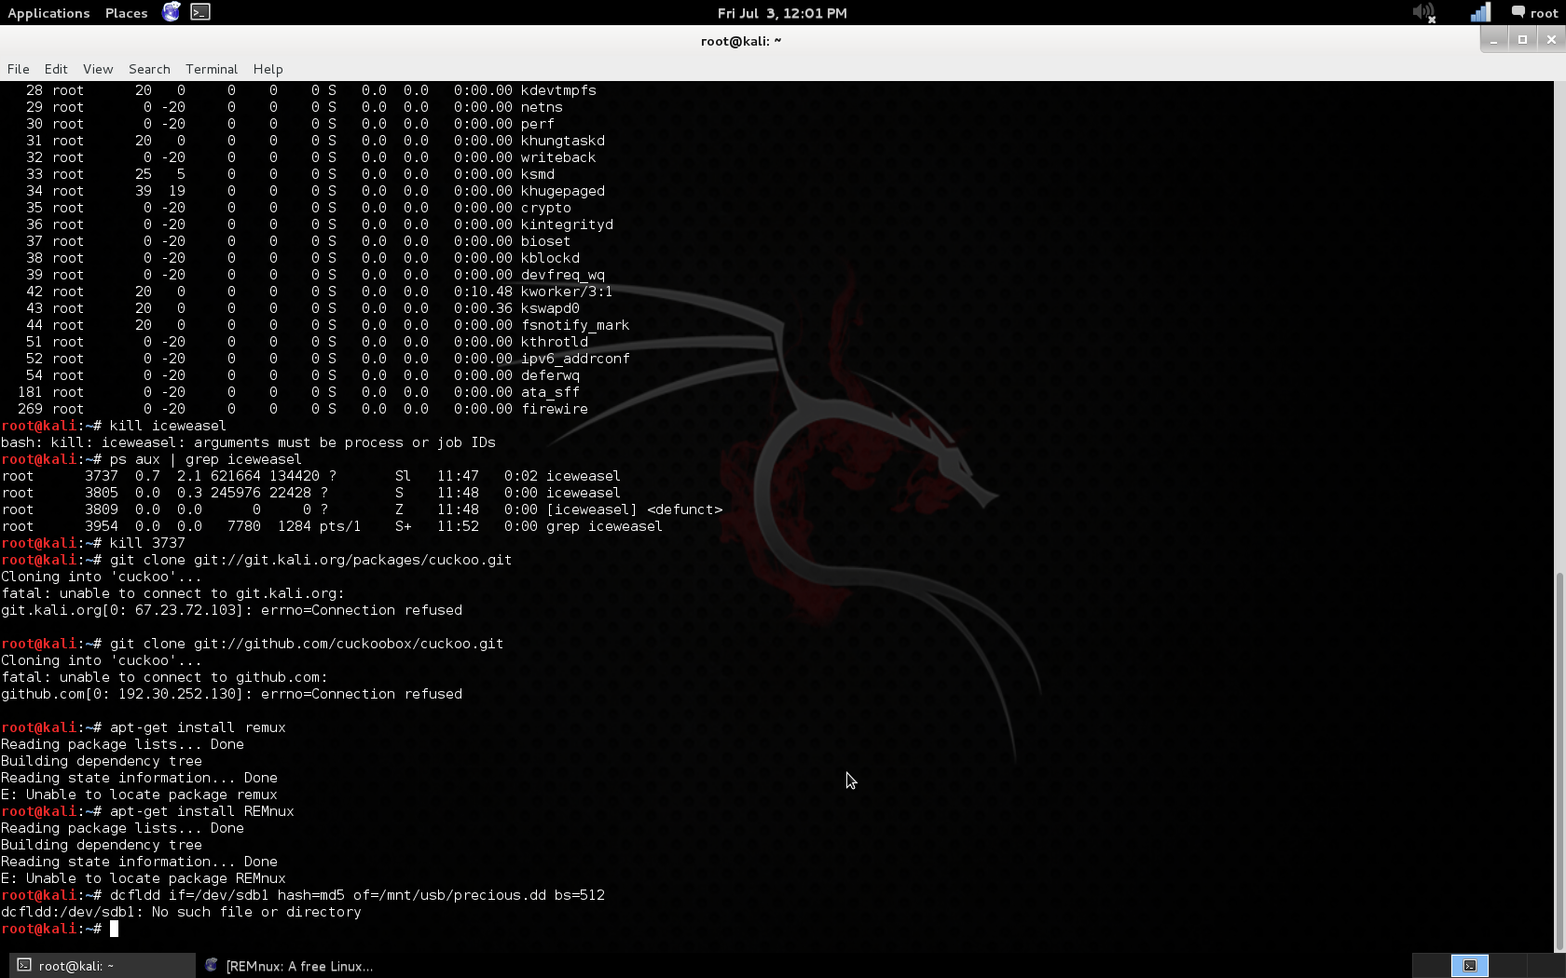
Mount the image in Linux
In order to mount the image we are going to use dcfldd which is a newer version of dd with more options
In this command if=/dev/sdb1 is the location of the image to mount
has=md5 is the type of hash that will be used
of=/mnt/usb/precious.dd is the file location to save it to
and bs=512 is the write speed, 512 bytes at a time

Slide 4
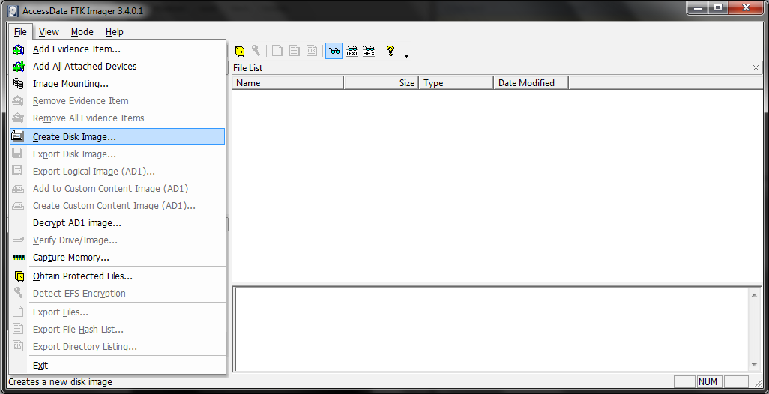
FTK: Make an Image
Install FTK Imager and click File a ‘Create Disk Image’ and go through the wizard.

Slide 5
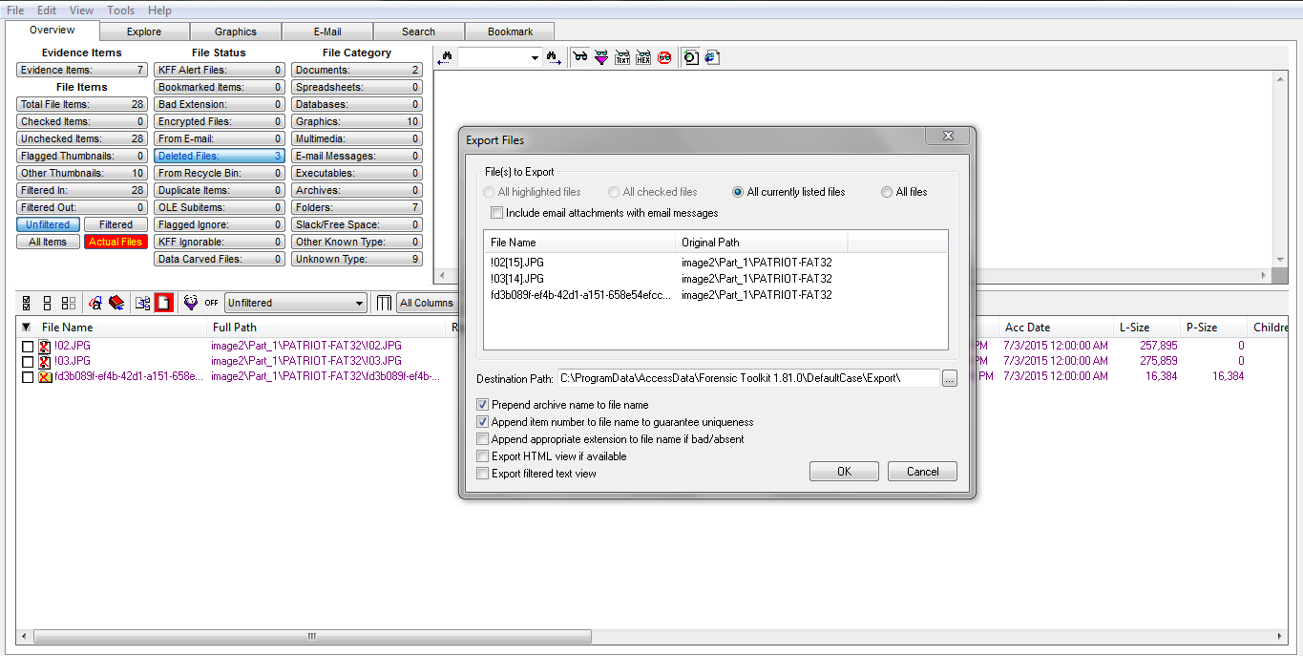
Export Deleted
Load the image into FTK. Then click ‘Deleted Files:’ and go to ‘File’ and ‘Export’ and specify the directory.

Slide 6
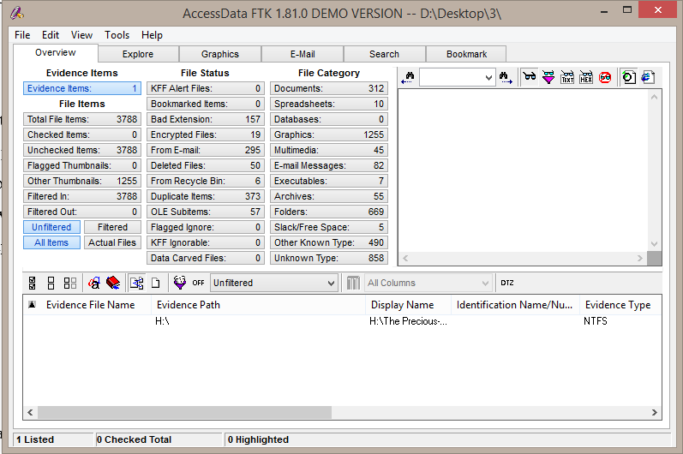
Report on the numbers and types of documents found
Go to the ‘Overview tab and it will list all the stats.

Slide 7
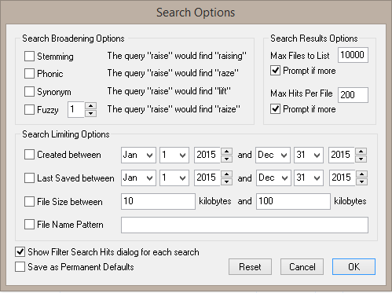
Show how the search function can be used with the four special options
The search options nifty tools that let you conduct a better search, mainly correcting human error. This includes Stemming, Phonics, Synonyms, and Fuzzy.

Slide 8
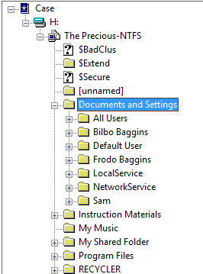
Identify User(s) of the computer the drive belonged to
In the Documents and Settings all the users are listed there by their home directories.

Slide 9
Identify People the user(s) know and their relation to each other
Looking through the emails we found a few people and some information:
Frodo is coming back home for the NASCAR race from London where he saw Eric Clapton
The gang went to Vegas to see a show that Frodo got tickets to from ebay
Pippin has been stealing Frodo’s lunch money
Frodo and Sam are starting a forensic company specializing in Forensic Computer Analysis called Hobbytes Consulting

Slide 10
Identify Personal information about as many people as possible
Natasha Daley
Sr. Regional Sales Manager
natasha@accessdata.com
www.accessdata.com
801.377.5410 x836
801.377.5426 fax
Mark Stringer
Senior Instructor
801-377-5410 x843
mark@accessdata.com
Jessica Parry
Technical Support
801-377-5410 x856
jessica@accessdata.com
Frodo Baggins
Hobbytes Inc
Baggifrodo@aol.com

Slide 11
Steganography
Steganography is the practice of concealing a file, message, image, or video within another file, message, image, or video. For example, a sender might start with an innocuous image file and adjust the color of every 100th pixel to correspond to a letter in the alphabet, a change so subtle that someone not specifically looking for it is unlikely to notice it.

Slide 12
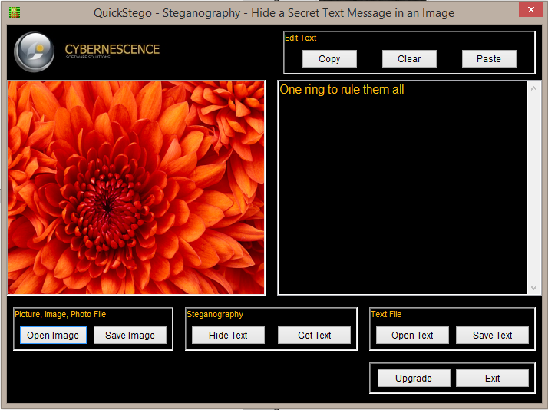
Steganography
All you have to do is open the QuickStego application
Click Open Image
And select your image

Slide 13
Phrases Gathered
One ring to rule them all
My preciousss
You shall not pass!
Then pen is mightier than the sword
This mortal form grows weak. I need sustanance!
There's no place like home
I am your father
I do not think that word means what you think it means

Slide 14
Resources
http://nest.unm.edu/files/2713/9251/5584/Tutorial_5_-_Kali_-_dcfldd_Imaging.pdf
http://accessdata.com/solutions/digital-forensics/forensic-toolkit-ftk
https://eforensicsmag.com/how-to-investigate-files-with-ftk-imager

